Slide 1
Case Presentation on Hypothyroidism
Submitted by
Lulu Nazar
B-Pharm 2016

Slide 2
A 86 year old female was admitted in the general medicine ward with a complaint of cough and decreased food intake.

Slide 3
SUBJECTIVE
OBJECTIVE
PLAN
ASSESSMENT

Slide 4
SUBJECTIVE

Slide 5
PATIENT DETAILS
NAME : X
AGE : 68 yrs
SEX : FEMALE
DEPT : GENERAL MEDICINE
DOA : 7/11/2017
DOD : 14/11/2017

Slide 6
REASON FOR ADMISSION
Cough and decreased food intake
PAST MEDICAL HISTORY
HTN , DM , Hypercholesterolism , Hypothyroidism
PAST MEDICATION HISTORY
Aztor 5 mg , Thyronorm 25mcg , Omintan 50mg

Slide 7
OBJECTIVE

Slide 8
PHYSICAL EXAMINATION
DATE | TEMP | BP | PULSE
7/11/17 | 102 | 130/70 | 72
8/11/17 | 101 | 140/80 | 72
11/2/17 | N | 140/80 | 72
12/2/17 | N | 130/90 | 76
13/2/17 | N | 120/80 | 80
PHYSICAL EXAMINATION
DATE | TEMP | BP | PULSE
7/11/17 | N | 140/80 | 82
8/11/17 | N | 130/80 | 84
9/2/17 | N | 130/90 | 82
10/11/17 | N | 130/90 | 82
11/11/17 | N | 130/90 | 82
12/11/17 | N | 140/90 | 80
13/11/17 | N | 140/90 | 78
14/11/17 | N | 150/90 | 72

Slide 9
HAEMATOLOGICAL TEST (9/2/17)
HAEMATOLOGICAL TEST
HAEMOGLOBIN (gm/dl) M: 11.5-15 F: 12.5 - 18 | TLC (cells /cumm) (5000 – 10000) | ESR (mm/hr) M<10, F<20 | PLATELETS (1 - 4.5 lakhs) | PCV ( 37 – 45 % )
11.9 | 10700 | 67 | 3.49 | 37.4
DIFFERENTIAL LEUKOCYTE COUNT (%)
POLYMORPHS (40-60) | LYMPHOCYTES (20-30) | BASOPHILLS (0-1) | EOSINOPHILS (1-4) | MONOCYTES (1-2)
62 | 35 | 2 | - | 1

Slide 10
RENAL FUNCTION TEST (7/11/17)
UREA : 26 mg/dl ( F: 10-30, M:15-45 )
CREATININE : 1.2 mg/dl ( F: 0.4-1.0, M: 0.6-1.4 )
URINE EXAMINATION (7/11/17)
ALBUMIN : slight trace
PUS CELLS : 8-10 hpf
RBC : 2- 4 hpf

Slide 11
LIVER FUNCTION TESTS
ALT/SGPT : 13 U/L (0 - 49)
AST / SGOT : 17 U/L (0 – 46)
BLOOD GLUCOSE LEVEL (7/11/17)
RBS : 119mg/dl ( 70-140)

Slide 12
HORMONE TEST
TSH : 6.07 IU (0.35 - 4.94)
OTHER INVESTIGATIONS
CHEST X - RAY (12/11 )
Impression ;plain axial CT section of thorax – normal CT study of thorax

Slide 13
ASSESSMENT

Slide 14
DIAGNOSIS
UPPER RESPIRATORY TRACT INFECTION AND
HYPOTHYROIDISM

Slide 15
UPPER RESPIRATORY TRACT INFECTION
Upper respiratory tract infection (URI) is a nonspecific term used to describe acute infections involving the nose, Para nasal sinuses, pharynx, larynx, trachea, and bronchi. The prototype is the illness known as the common cold,

Slide 16
EPIDEMIOLOGY
Children have 2-9 viral respiratory tract infection per year
In 2013 18.8 billion cases of urti were reported
As of 2014 , urti caused about 3000 death down from 4000 in 1990
In US , URTIs are the most common infectious illness in the general population

Slide 17
ETIOLOGY
The majority of upper respiratory tract infections are caused by a viral illness. The most common viruses responsible for upper respiratory infections are:
Rhinovirus
Para influenza virus
Coronavirus
Adenovirus
Respiratory syncytial virus
*some times it is also result from bacterial infection , allergens, dust etc.

Slide 18
PATHOPHYSILOGY

Slide 19
General pathophysiology of URTI
Bacteria , Virus
Direct hand –hand contact Droplet infection
Enters the nose by inhaling
Immune defences
Hair lining filters and trap some pathogens
Traps in upper respiratory tract which coats by mucus
Junction of the posterior nose to pharynx
Transport pathogens upto pharynx
Inflammatory response to immune system
Increased mucus secretion ,fever ,swelling ,running nose ,etc.

Slide 20
CLINICAL MANIFESTATIONS
Nasal congestion,
Runny nose
Nasal discharge that may change colour from clear to white to green.
Nasal breathing
Sneezing
Sore or scratchy throat,
Painful swallowing.
Cough (from laryngeal swelling and post nasal drip),
Malaise
Fever that is very common in children.

Slide 21
INVESTIGATIONS
Mucus / sputum culture
Chest X-ray
Blood routine
CT scan
Allergy testing

Slide 22
HYPOTHYROIDISM
A clinical state resulting from decreased circulating levels of free thyroid hormone or from resistance to hormone

Slide 23
EPIDEMIOLOGY
It can occur at any age but predominantly over the age of 40
Females are more affected than males
Pre valance is around 10 in 1000 people

Slide 24
ETIOLOGY
20 % of hypothyroidism results from destruction of the gland as a result of treatment of
1. hyperthyroidism
2. Addison's diseases
3. Drug induced e.g. : iodides

Slide 25
PATHOPHYSIOLOGY

Slide 26
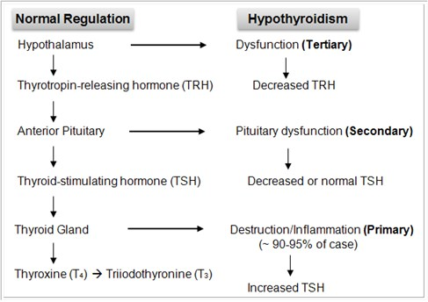

Slide 27
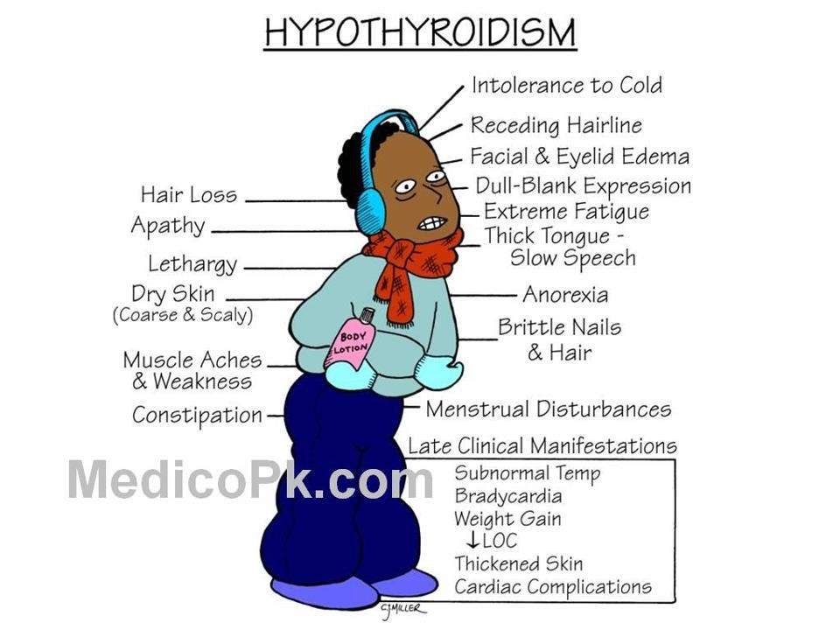
CLINICAL MANIFESTATIONS

Slide 28
INVESTIGATIONS
Evaluation of
TSH level
T3 and T4 level
Ultrasound scan
Radioisotope imagining
Neck x ray

Slide 29
GOALS OF TREATMENT
Eradicate the organism .
Relieve symptoms.
Prevent recurrence of infection.
Improve overall condition of patient.
Normalise the TSH level

Slide 30
STANDARD TREATMENT REGIMEN ( URTI)
Antibiotics (amoxicillin +clavulanic acid)
Mucolytics
Expectorant
Nebulization

Slide 31
STANDARD TREAT MENT REGIMEN (HYPOTHYROIDISM)
Hormone replacement therapy
Administered orally with a bioavailability ranging from 48-80 %
1. Levothyroxine - synthetic T4
2. Liothyronine - synthetic T3
3. Liotrix - combination of synthetic T3 and T4
Dosage specific to individual and is determined by their TSH serum levels . Typically 1.5 mcg per kg body weight .

Slide 32
PLAN

Slide 33
SL. NO | TRADE NAME | GENERIG NAME | DOSE | 7/ 11 | 8/ 11 | 9/ 11 | 10/ 11 | 11/ 11 | 12/ 11 | 13/11 | 14/ 11
1 | T. CLAMCHEK 625 | AMOXICILLIN+ CLAVULANIC ACID | 500mg+ 125 mg TID | ✓ | ✓ | ✓ | ✓ | ✓ | ✓ | ✓ | ✓
2 | SYP . ALEX SF | DEXTROMETHORPHAN+ GUAIFENESIN+CHLORPHENIRAMINE+PHENYLEPHRINE | 10mg/5ml+100mg/5ml+4mg/5ml+5mg/5ml BD |  | ✓ | ✓ | ✓ | ✓
3 | STEAM INHALER |  | BD | ✓ | ✓ | ✓ | ✓ | ✓
4 | INJ AMICIN | AMIKACIN | 500mg BD | ✓ | ✓ | ✓ | ✓ | ✓ | ✓ | ✓ | ✓
5 | NEB .WITH DUOLIN | SALBUTAMOL+IPRATROPIUMBROMIDE | HS |  | ✓ | ✓ | ✓ | ✓

Slide 34
6 | MUCOLITE | AMBROXOL | 30 mg TID |  |  | ✓ | ✓ | ✓
7 | T . RAZO | RABEPRAZOLE | 20 mg 1-1-0 | ✓ | ✓ | ✓ | ✓ | ✓ | ✓ | ✓ | ✓
8 | SYP FLOREX | CHLORPHENIRAMINE+DEXTROMETHORPHAN+PHENYLEPHRINE | 2mg+10mg+5mg/5ml 1 tsp- 0- 2 tsp |  |  |  |  |  | ✓ | ✓ | ✓
9 | T . THYRONORM | LEVO - THYROXINE | 25mcg 1-0-0 | ✓ | ✓ | ✓ | ✓ | ✓ | ✓ | ✓ | ✓

Slide 35
DISCHARGE MEDICATION
T .CLAMCHECK 625 1-0-1 7days
T . RAZO 0-1-0 7 days
R/A 7 days

Slide 36
COUNSELLING POINTS
Take Antibiotics as prescribed by the physician
Complete the course of antibiotics
Antibiotics are better to take with food to avoid stomach upsets
Use towel while sneezing
Points to keep in mind while using steam inhaler
1 .use on a firm surface
2 .fill or remove water after turning it off
3 .do not add other substance to increase the steam
4 .keep the instrument away from children
Continue the past medications properly
. Decrease salt intake
Take plenty of water
Monitor BP and blood sugar
Decrease carbohydrate rich food
Maintain personal hygiene
Keep away from dust and allergens

Slide 37
PHARMACIST INTERVENTION
Culture and sensitivity test should be performed before prescribing Antibiotics

Slide 38
THANK YOU

